Slide 1
PROJECT 1

Slide 2
Stock Market Trend Analysis & Forecasting
A Comparative Study of AAPL, MSFT, GOOGL, and NFLX
Presented by: Mufaddal Jhalod

Slide 3
Objective of the Project
- Analyze stock price patterns of major tech companies.
- Identify moving averages and volatility.
- Examine correlations between stock prices.
- Use insights to predict potential market behavior.

Slide 4
Data Source & Structure
- Data Period: Last 3 Months
- Stocks Covered: Apple, Microsoft, Netflix, Google
- Structure: Date, Ticker, Open, High, Low, Close, Volume
- Data Format: CSV

Slide 5
Step 1 - Data Cleaning and Preprocessing
- Removed nulls & checked for consistency.
- Converted 'Date' field to datetime.
- Standardized Ticker names.
- Ensured numeric integrity of price columns.

Slide 6
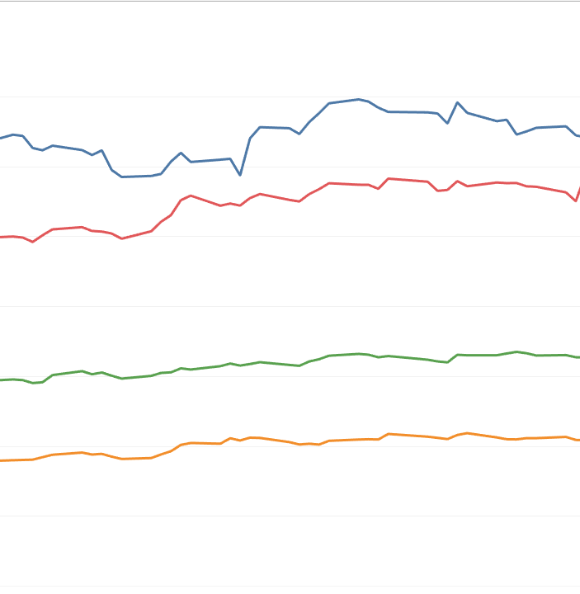
Step 2 - Creating Line Charts of Close Prices
- Created separate line charts for each stock.
- Analyzed daily price trends.
- Observed volatility visually over time.

Slide 7
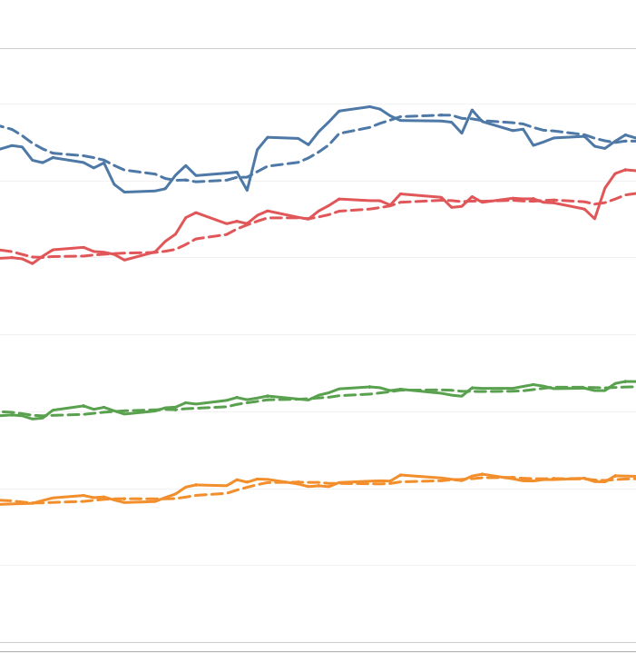
Step 3 - Moving Averages (7-Day & 14-Day)
- Calculated MA7 and MA14 for smoothing trends.
- Used Tableau table calculations.
- Visual overlays on Close Price charts.

Slide 8
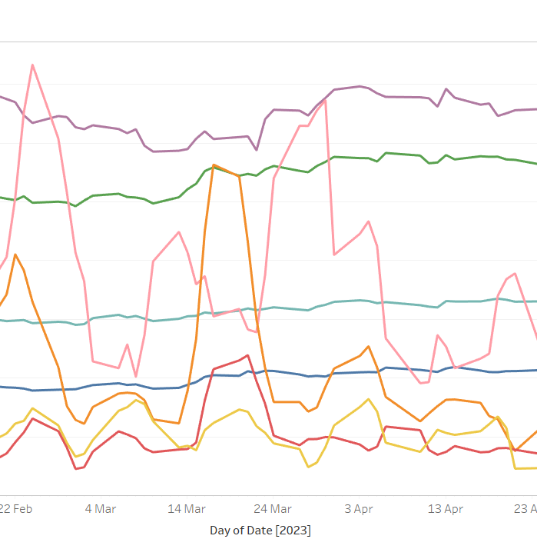
Step 4 - Volatility Analysis (Standard Deviation)
- Measured 7-day rolling standard deviation.
- Created volatility trend lines.
- Identified high-risk periods visually.

Slide 9
Step 5 - Combined Visualization Dashboard
- Integrated Close Price + MA + Volatility.
- Added interactivity with filters (Date, Ticker).
- Enabled detailed multi-stock comparison.

Slide 10
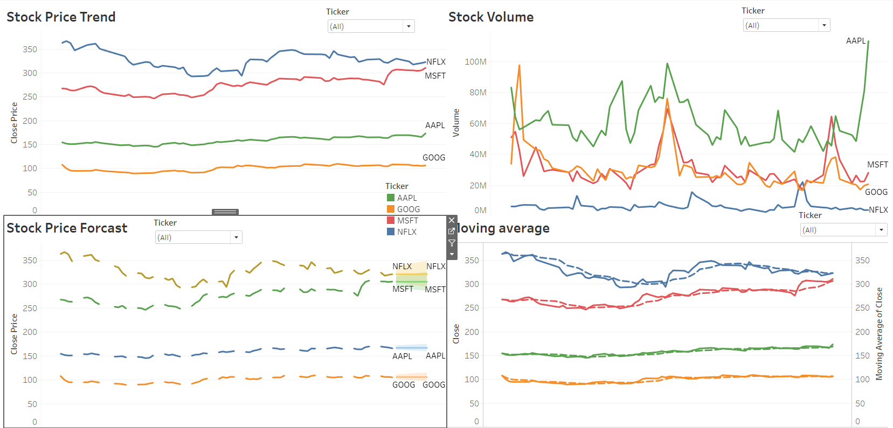
Sample Correlation Output

Slide 11
Step 6 - Correlation Analysis Between Stocks
- Pivoted data to wide format (each ticker as column).
- Created scatter plots: AAPL vs MSFT, GOOGL vs NFLX etc.
- Added linear trendlines to show R² values.

Slide 12
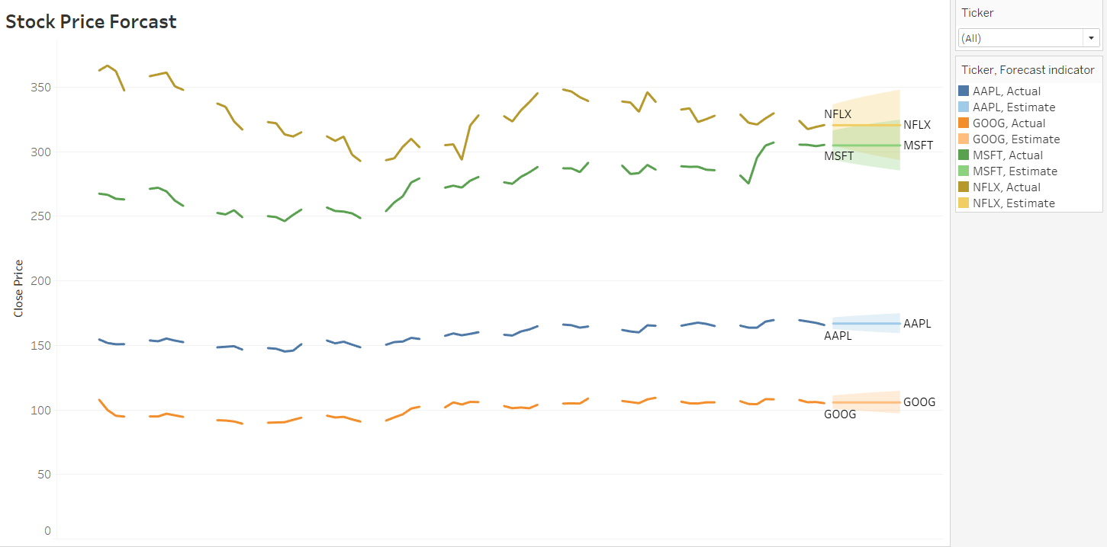
Step 7 - Market Insights Derived
- AAPL & MSFT highly correlated → likely driven by similar macro events.
- NFLX showed more independent movement.
- Volatility spikes around major earnings dates.

Slide 13
Step 8 - Prediction Possibilities Using ML (Next Phase)
Price
- Features: Close price, MA7, MA14, Volatility.
Model
- Model: Linear Regression, XGBoost (Planned).
Goal
- Goal: Short-term movement classification.

Slide 14
Challenges Faced
- Missing trendline options in latest Tableau (v2025.1)
- Required data reshaping outside Tableau.
- Visualization limit with long-format data.

Slide 15
Recommendations
- Use pivoted data model for correlation tasks.
- Incorporate Python preprocessing for complex metrics.
- Explore ML model deployment using Tableau extensions.

Slide 16
PROJECT 2

Slide 17
Daily Transaction & Spending Analysis
Presented by: Mufaddal Jhalod

Slide 18
Project Overview
Goal: To analyze a dataset of daily household transactions to identify spending patterns, visualize financial habits, and create an interactive tool for personal budget management.
Key Objectives:
To clean and prepare the raw transaction data for analysis.
To build an interactive Tableau dashboard to visualize key financial metrics.
To analyze income vs. expense trends.
To identify the top spending categories and subcategories.
To understand which payment modes are used most frequently.

Slide 19
Dataset & Tools
Dataset: "Daily Household Transactions“
2,461 total transactions
8 key columns : Date , Mode , Category , Subcategory , Amount , Income/Expense , Note , Currency
All transactions are recorded in INR.
Primary Tool:
Tableau Desktop: Used for all data cleaning, preparation, analysis, and visualization.

Slide 20
Data Preparation in Tableau
Data Type Correction: Converted the Date field from a text string to a formal Date data type to enable time-series analysis
Handling Nulls: Addressed missing data in key analytical fields:
635 null values in Subcategory
521 null values in Note
Calculated Fields:
Created Income, Expense, and Transfer-Out measures from the Amount column to properly segment financial flows.
Grouped similar subcategories (e.g., 'Train' and 'train') for cleaner analysis.

Slide 21
Interactive Finance Dashboard
Key Features (add brief callouts):
KPIs: High-level totals for Income, Expense, and Transfers.
Interactive Filters: Users can filter by date range, category, and payment mode.
Drill-Down: Users can click on a Category to see the Subcategory breakdown.

Slide 22
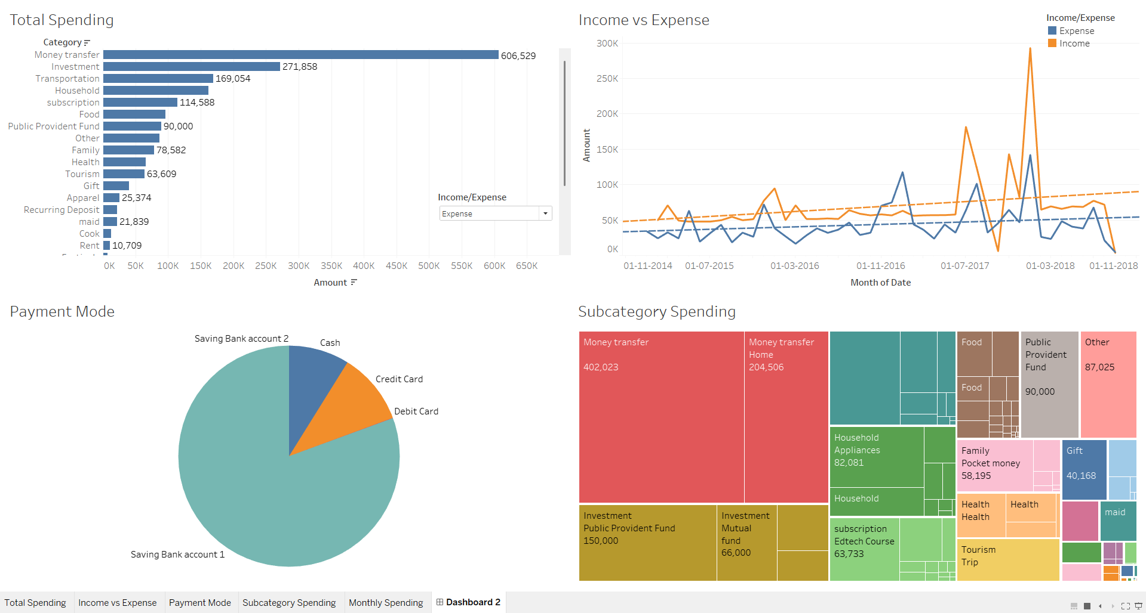

Slide 23
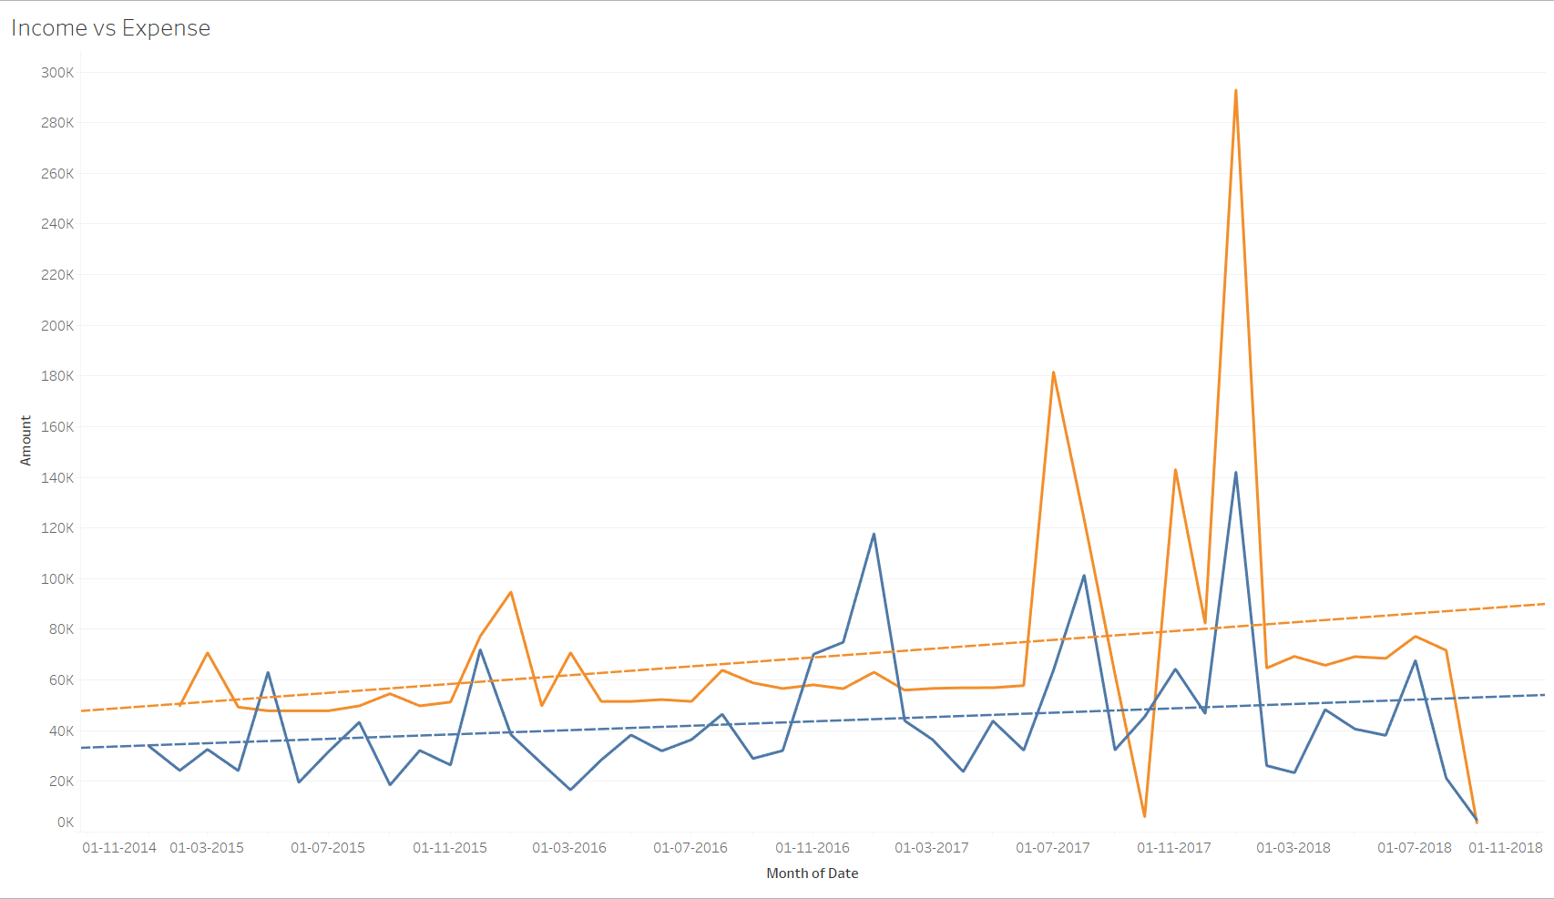
Insight: High-Level Financial Flow
Finding: The dataset is overwhelmingly composed of Expenses.
Observation: 'Transfer-Out' is a major category, distinct from daily expenses. This primarily includes savings and investments, such as 'Public Provident Fund' , 'Equity Mutual Fund' , and 'Life Insurance'.

Slide 24
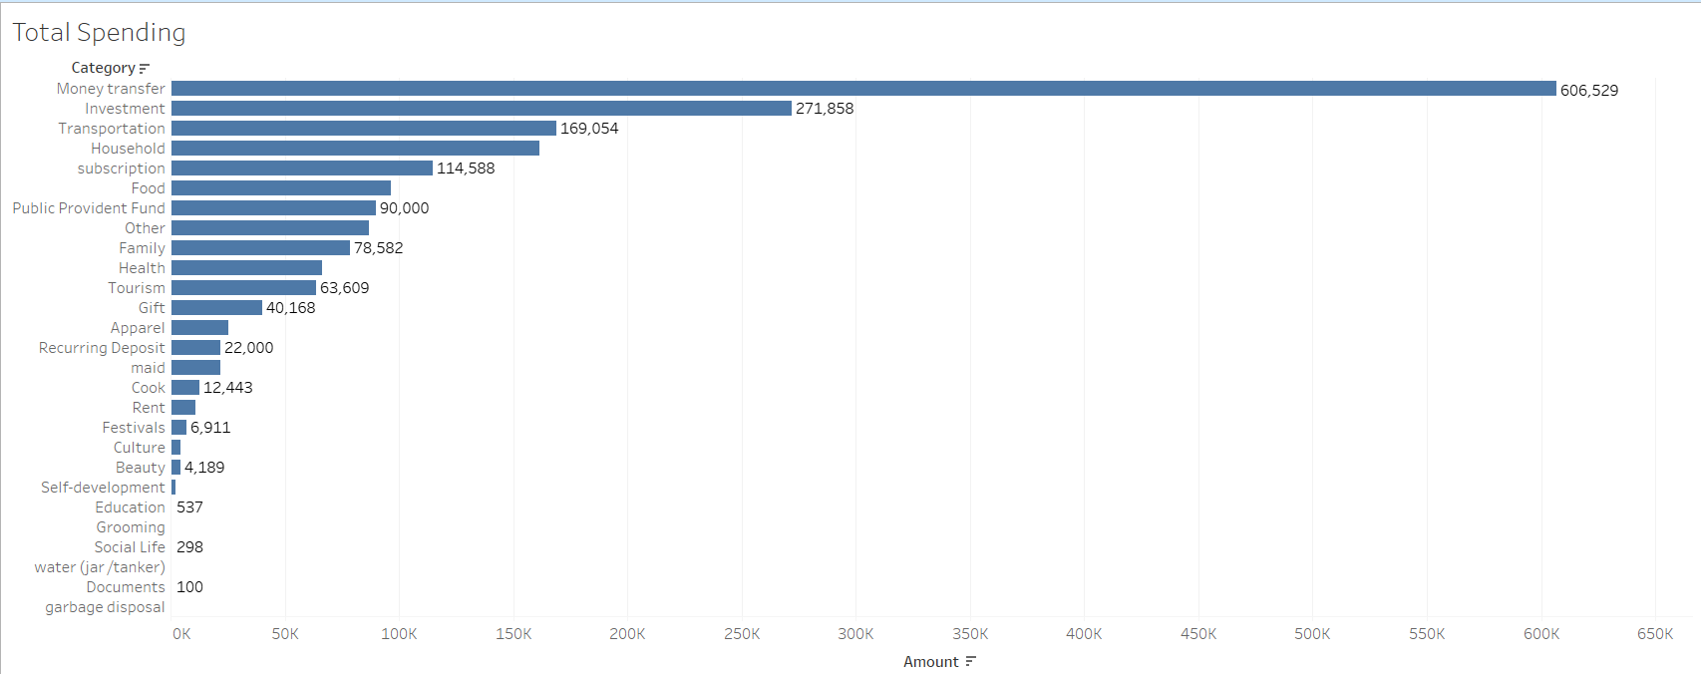
Insight: Where is the money going?
Finding (By Count): The top 5 categories are Food (907 transactions) , Transportation (307) , Household (176) , subscription (143) , and Other (126).
Finding (By Subcategory): The most frequent individual purchases are Milk, auto, snacks, and Grocery .

Slide 25
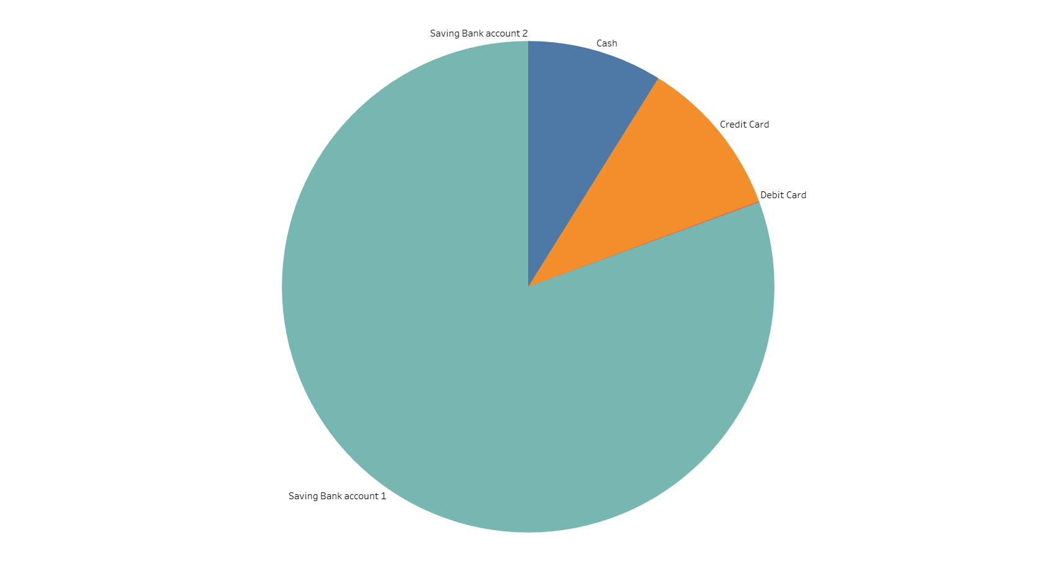
Insight: How are we paying?
Finding: Transactions are dominated by two main payment modes:
Saving Bank account 1 (1,223 transactions)
Cash (1,046 transactions)
Observation: This suggests a financial profile that relies heavily on direct debit and cash, with much less frequent Credit Card use (162 transactions).

Slide 26
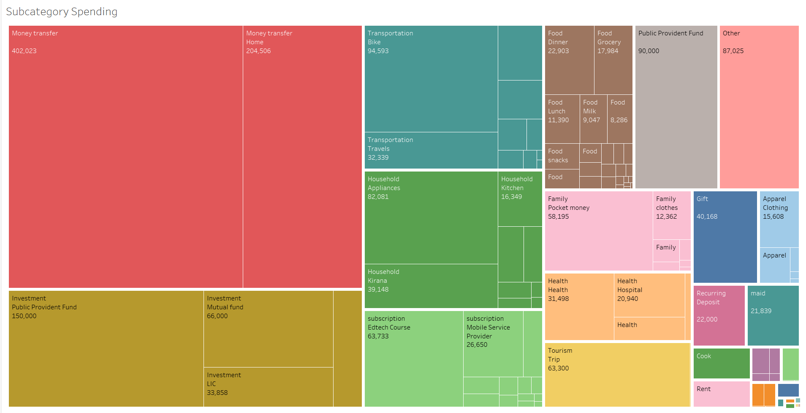
Insight: Identifying Spending By Sub-category
Finding: The tree map is essential for spotting large purchases and large areas of expense.
Key Examples:
₹402,023 for ‘Money Transfer'
₹82,081 for ‘Appliance’
₹150,000 for ‘Investment'

Slide 27
Challenges & Future Scope
Challenges:
Data Inconsistency: The Subcategory field had 635 null values , and free-text Note field made some categorization difficult.
Manual Data: The dataset is a snapshot and not a live feed, limiting real-time analysis.
Future Scope:
Forecasting: Use Tableau's forecasting tools to predict future spending based on past trends.
NLP on Notes: Apply Natural Language Processing to the Note field to extract entities (like "Netflix", "Ola cab") to automate subcategory creation.
What-If Analysis: Create parameters to see how (e.g.) a 10% reduction in "Food" spending would impact overall savings.

Slide 28
Conclusion & Recommendations
Conclusion:
This Tableau dashboard successfully transformed a raw CSV into an interactive financial tool. It clearly identifies that Food and Transportation are the primary areas of expenditure, mostly paid for by Bank Account and Cash.
Recommendations:
For Budgeting: An individual using this data should focus on managing the 'Food' category, specifically 'snacks' and 'Lunch', for the greatest impact on savings.
For Review: The 'Subscription' category shows many small, recurring costs that should be reviewed periodically.

Slide 29
PROJECT 3

Slide 30
Analysis of Electric Vehicle Sales in India A Data-Driven Review Using Microsoft Excel
Presented by: Mufaddal Jhalod

Slide 31
Project Overview and Objectives
Project Goal: To analyze the provided dataset on Electric Vehicle (EV) sales in India to uncover key trends, identify market leaders, and understand consumer preferences.
Core Objectives:
To identify the top-performing states in EV adoption.
To analyze the growth trajectory of EV sales over time.
To determine the most popular EV categories and types.
Tool Used: All data cleaning, analysis, and visualization were performed using Microsoft Excel.

Slide 32
Step 1 - Data Cleaning & Preparation
Data Validation: Checked for and removed any duplicate entries to prevent skewed results.
Standardization: Formatted the 'Date' column to a consistent MM/DD/YYYY format for accurate time-series analysis.
Data Typing: Ensured the EV_Sales_Quantity column was correctly formatted as a number to allow for mathematical calculations

Slide 33
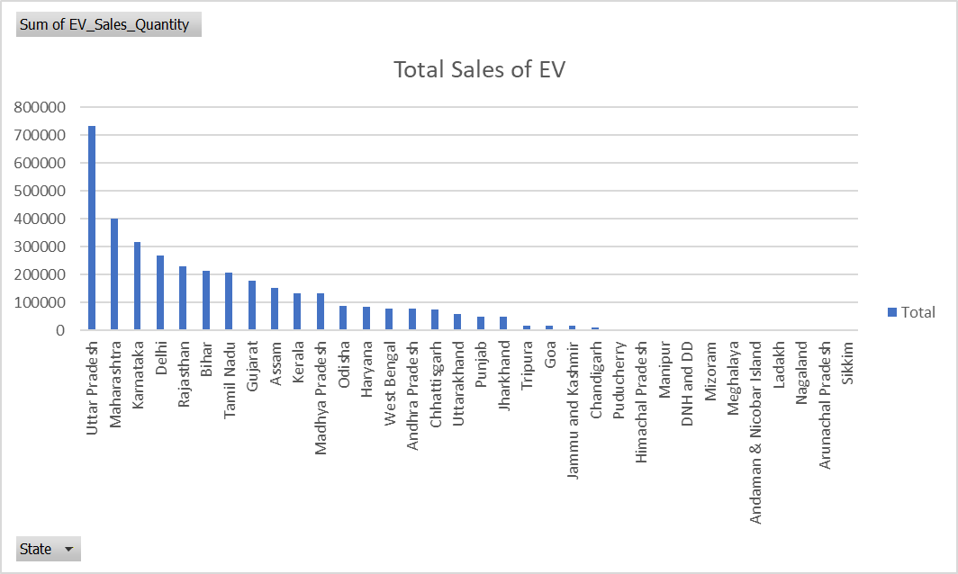
Step 2 - State-Level Analysis
Talking Point: "To understand the geographic distribution of EV sales, we first aggregated the total sales quantity by state. This helps us identify the key markets in the country.“
Method: A PivotTable was used to sum the EV_Sales_Quantity for each State.
Observation: The chart clearly highlights a few states that are significantly outpacing others in EV adoption. Uttar Pradesh, Maharashtra, and Karnataka emerge as the top 3 markets.

Slide 34
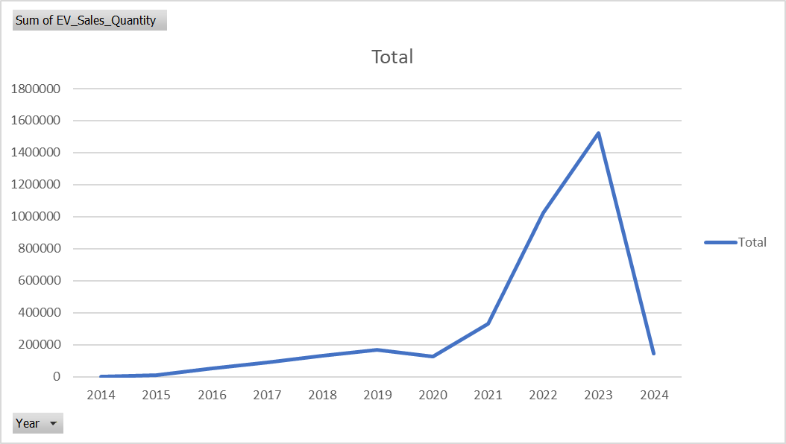
Step 3 - Market Growth
Talking Point: "Next, we wanted to understand the overall market trend. Are EV sales growing, and if so, how quickly? We analyzed the total sales for each year.“
Method: A PivotTable was created to sum EV_Sales_Quantity by Year.
Observation: The line chart shows a slow start followed by a period of exponential growth, particularly from 2021 onwards. This indicates a significant acceleration in consumer adoption in recent years.

Slide 35
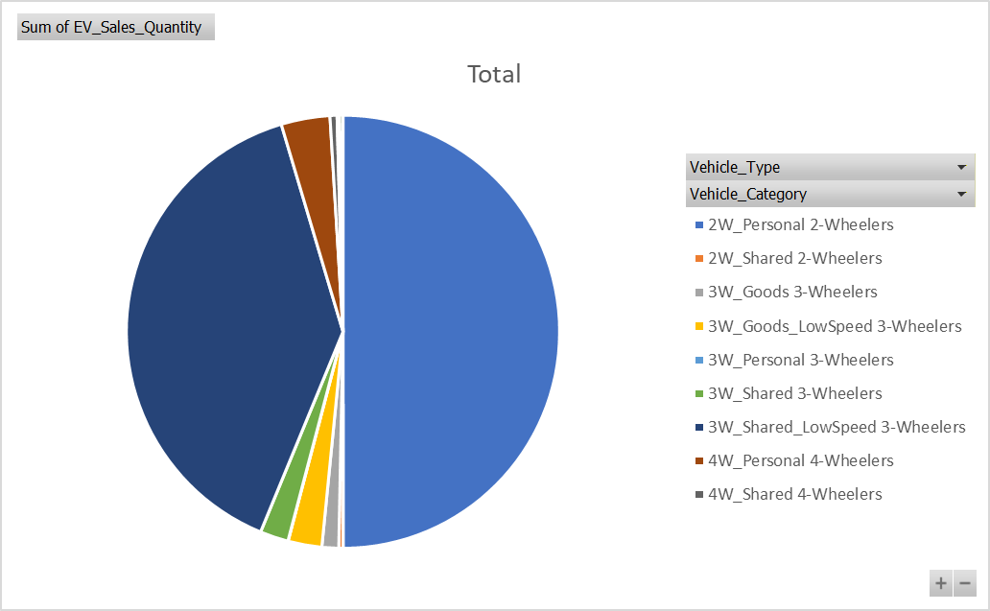
Step 4 - Vehicle Preferences
Talking Point: "After looking at where and when EVs are being sold, we analyzed what types of vehicles are most popular. This is crucial for understanding consumer demand.“
Method: We used a PivotTable to group sales by Vehicle_Category.
Observation: The pie chart reveals that the market is overwhelmingly dominated by 2-Wheelers and 3-Wheelers. This suggests that personal mobility and last-mile logistics are the primary drivers of the EV transition in India.

Slide 36
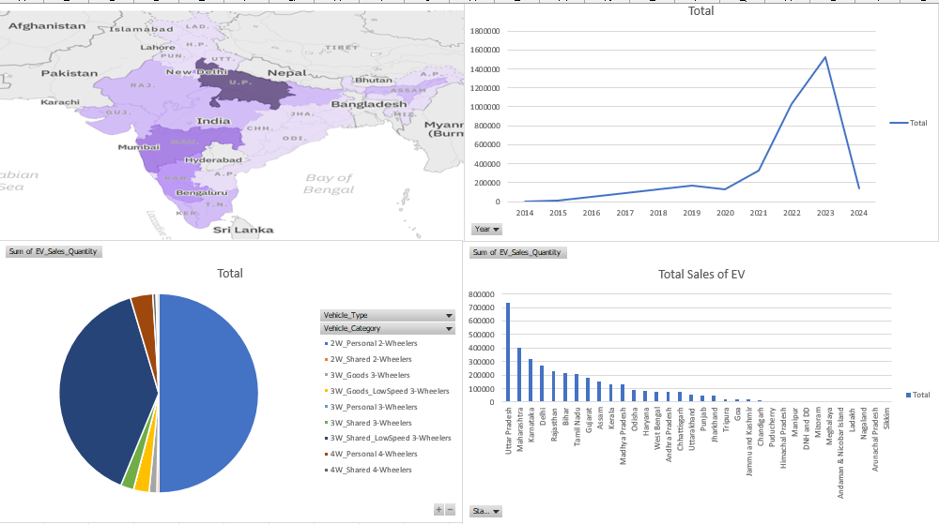
Step 5 - A Dynamic View
Talking Point: "To bring all these insights together and allow for deeper exploration, we created a fully interactive dashboard in Excel. This tool allows us to filter the data dynamically.“
Features:
Centralized View: All key charts are visible on a single screen.
Slicers & Timelines: Users can filter the entire dashboard by State, Vehicle Type, Vehicle Category, and a specific Date range.

Slide 37
Summary of Key Findings
Geographic Concentration: A few key states, including Uttar Pradesh, Maharashtra, and Karnataka, are driving the majority of EV sales in India.
Explosive Market Growth: The Indian EV market is in a high-growth phase, with a significant inflection point in sales around 2021.
Two-Wheeler Dominance: The 2-Wheeler segment is the largest by a significant margin, defining the current landscape of the Indian EV market.
Commercial Viability: The strong performance of the 3-Wheeler category points to a rapid electrification of commercial and public transport fleets.

Slide 38
Conclusion & Recommendations for Future Analysis
Conclusion: The analysis confirms that India's EV market is expanding rapidly, driven by specific vehicle segments and geographic regions. Microsoft Excel served as an effective and powerful tool for conducting this end-to-end analysis.
Recommended Next Steps:
Policy Correlation: Analyze the impact of state-level government subsidies and policies on EV sales figures.
Infrastructure Analysis: Correlate sales data with the availability of charging infrastructure to see if there is a link.

Slide 39
PROJECT 4

Slide 40
Road Accident Data Analysis 2020 – India
Presented By : Mufaddal jhalod

Slide 41
Project Objective
Goal:
To analyze road accident patterns in Indian cities and identify key causes, outcomes, and safety insights for 2020.
Key Questions:
Which cities had the highest accidents?
What were the most common causes?
How do causes relate to fatalities or injuries?

Slide 42
Dataset Overview
Source: data.gov.in (Road Accidents in India – 2020)
Dataset Columns:
Cities
Cause Category
Cause Subcategory
Outcome of Incident
Count (in numbers) Scope: 50 Indian cities

Slide 43
Tools and Techniques
Tools: Microsoft Excel
Techniques Used:
Data Cleaning (Remove duplicates, blanks)
Pivot Tables for aggregation
Charts for visualization
Dashboard for summary insights

Slide 44
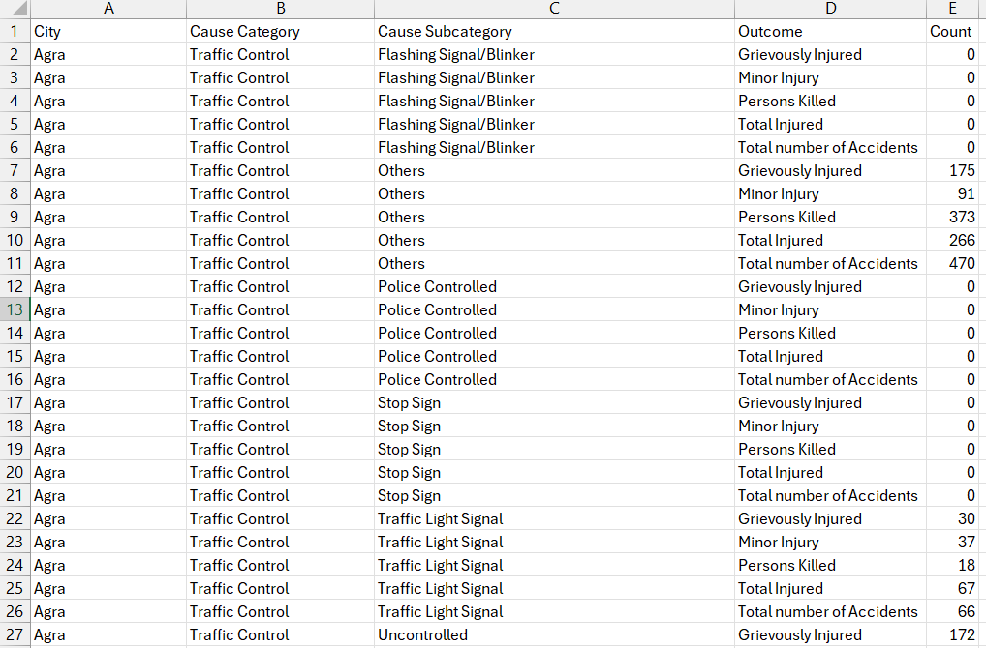
Data Cleaning Steps
Steps:
Removed duplicates
Filled missing values with 0
Standardized column names
Filtered unwanted rows

Slide 45
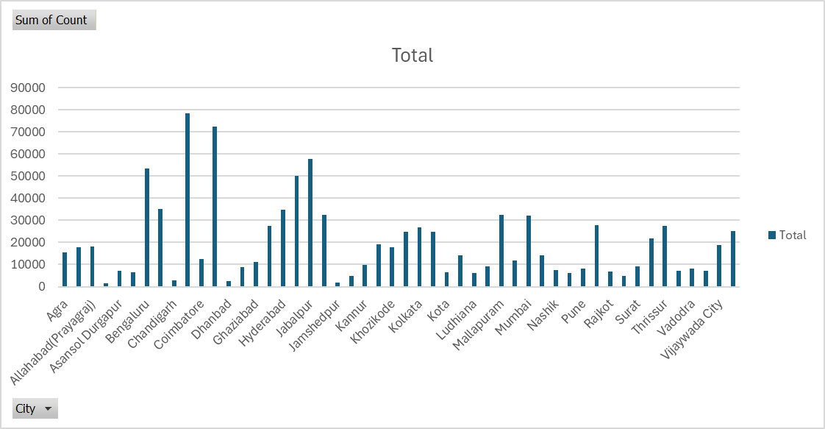
Total Accidents by City
Insight: Highlight top 5 cities with highest accident counts (e.g., Delhi, Mumbai, Chennai, Bengaluru, Hyderabad).
Observation: Metropolitan areas show maximum incidents due to higher vehicle density.

Slide 46
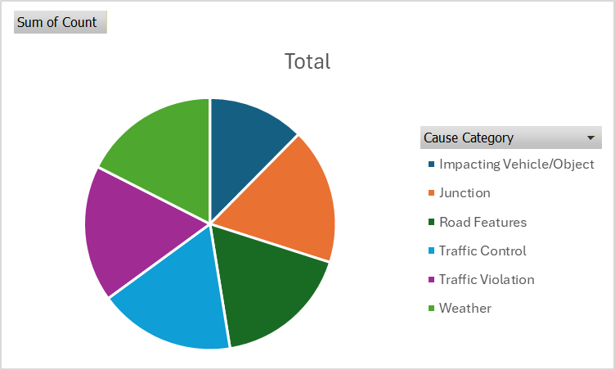
Accidents by Cause Category
Categories: Traffic Violation, Weather, Junction, Road Features, etc.
Observation: Traffic Violations and Road Features contribute most accidents.

Slide 47
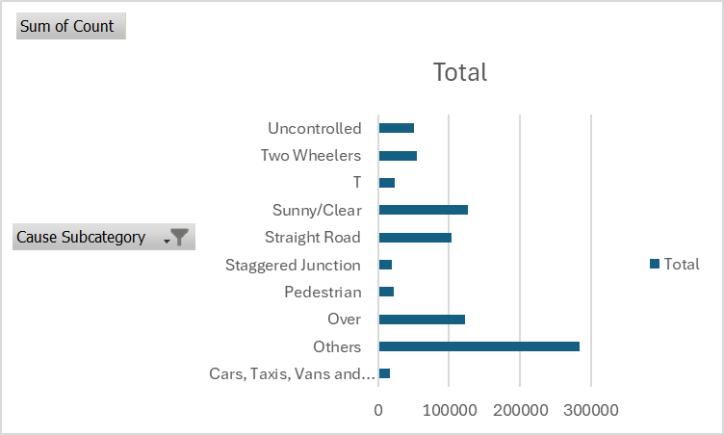
Analysis by Cause Subcategory
Examples: Drunken Driving, Rainy Weather, Jumping Signal, Potholes.
Insight: Drunken driving and poor road conditions are major contributors.

Slide 48
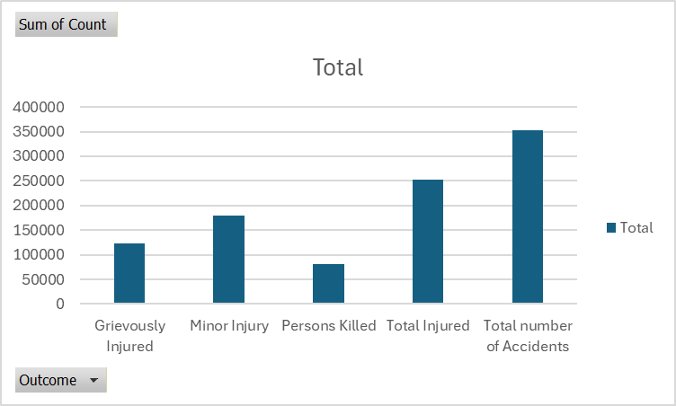
Outcomes of Accidents
Insight: Most cases involve injuries, but fatalities are significant in traffic-violation categories.

Slide 49
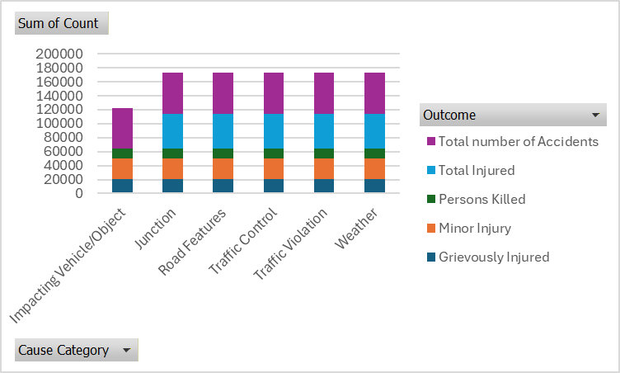
Cause vs Outcome Relationship
Observation:
Traffic Violation → highest deaths
Weather Conditions → fewer but severe accidents

Slide 50
Insights & Findings
Delhi & Mumbai = most accident-prone cities.
Top causes: Traffic Violations & Road Features.
Drunken driving & over speeding → major fatal outcomes.
Poor road maintenance also a big factor.

Slide 51
Conclusion & Recommendations
Conclusion:
Road safety measures need improvement in high-density cities.
Recommendations:
Strict law enforcement on traffic violations.
Improve road quality & lighting.
Promote awareness on safe driving.
Install better traffic-control systems.

Slide 52
PROJECT 5

Slide 53
Coffee Vending Machine Sales Analysis Data
Presented by: Mufaddal Jhalod

Slide 54
Project Goal & Objectives
To analyze transactional sales data from March 1 to July 31, 2024, to understand purchasing patterns and sales trends.
To identify the most popular products, peak sales times, and key customer behaviors.
To provide data-driven recommendations to aid in inventory planning and improve operational efficiency.

Slide 55
Data Set Overview
Source: Transactional records from a coffee vending machine.
Period: The dataset covers all sales from March 1, 2024, to July 31, 2024.
Volume: A total of 1,133 individual transactions were analyzed.
Key Fields: The data includes transaction date/time, payment type (cash/card), price, and the specific coffee name.

Slide 56
Methodology
Data Preparation: Loaded the raw CSV data, handled missing values related to cash payments, and checked for duplicates.
Feature Engineering: Created new helper columns for Month, Day of the Week, and Hour to enable time-series analysis.
Analysis & Visualization: Used Microsoft Excel as the primary tool. Leveraged PivotTables and PivotCharts to aggregate, analyze, and visualize the data.

Slide 57
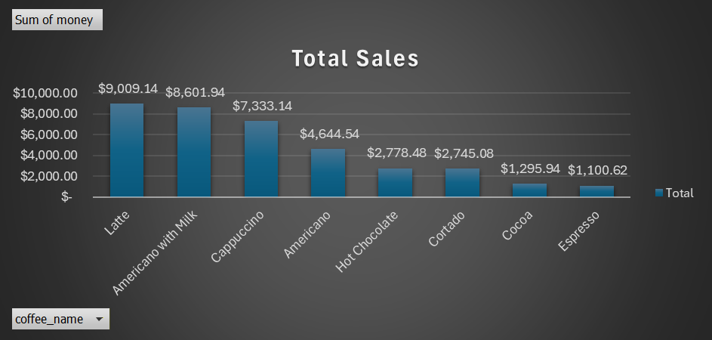
Product Popularity
Key Insight 1: Latte is the highest revenue-generating product, bringing in over ₹9,000.
Key Insight 2: Americano with Milk is the most frequently purchased coffee, followed closely by Latte and Cappuccino.
Key Insight 3: Espresso and Cocoa are the least popular products, both in terms of sales volume and revenue.

Slide 58
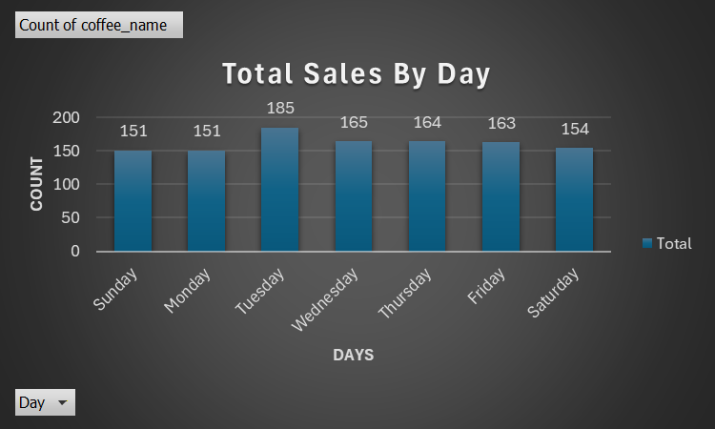
Weekly Sales Trend
Key Insight: The analysis reveals a clear peak in sales volume on Tuesdays.
Observation: Sales on other days of the week are relatively stable and similar to one another.

Slide 59
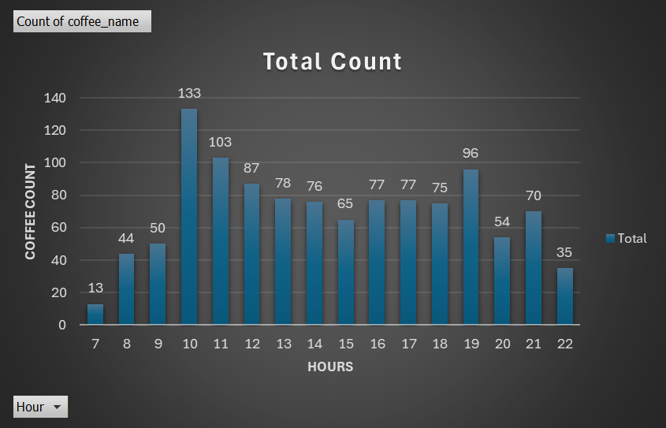
Daily Sales Trend
Key Insight: The data reveals two distinct sales peaks during the day: a major rush at 10:00 AM and a smaller, secondary rush at 7:00 PM (19:00).
Observation: The morning peak is significantly larger, with Latte sales being a major contributor to this rush.

Slide 60
Summary of Insights
WHAT: Latte and Americano with Milk are the star products.
WHEN: The busiest day is Tuesday, and the peak times are 10 AM and 7 PM.
HOW: Card payments are overwhelmingly preferred, accounting for ~92% of all transactions.

Slide 61
Actionable Recommendations
Optimize Morning Inventory:
Ensure vending machines are fully stocked with Latte and Americano with Milk before 9:30 AM daily to capitalize on the 10 AM peak.
Targeted Restocking Schedule:
Plan the main weekly restocking for Monday evening or early Tuesday morning to prepare for the busiest day.
Implement an Evening Stock Check:
Perform a quick stock check before 6:00 PM, paying special attention to evening favorites like
Cappuccino and Hot Chocolate, to prepare for the 7 PM rush.

Slide 62
Conclusion
Summary: This analysis provides a clear, data-backed strategy for optimizing vending machine operations.
Impact: By aligning our inventory management with observed customer behavior, we can reduce missed sales opportunities and improve customer satisfaction.
Future Scope: Future analysis could involve tracking individual customer purchases (via anonymous card data) to explore customer loyalty and repeat purchase behavior.

Slide 63
PROJECT 6

Slide 64
E-commerce Furniture Analysis 2024
Presented By : Mufaddal Jhalod

Slide 65
Project Objective
Objective: To analyze sales data from an e-commerce furniture dataset to identify key drivers of sales and build a predictive model in Excel to forecast the number of units sold.
Dataset: 2,000 product listings scraped from AliExpress.
Tools Used: Microsoft Excel (including PivotTables, Power Query, and the Data Analysis).
Project Goal: Provide actionable recommendations for sellers to optimize pricing, listings, and shipping tags to maximize sales.

Slide 66
Our Approach
Data Cleaning:
Removed non-numeric characters (e.g., "$", ",") from price and originalPrice columns.
Converted price columns to numeric values for calculation.
Filled 3 minor missing tagText values with "Unknown".
Feature Engineering
Created three new columns to deepen the analysis:
Total_Revenue = price * sold
Discount_Amount = originalPrice - price
Discount_Percentage = (originalPrice - price) / originalPrice

Slide 67
Agenda
Data Collection & Understanding
Data Preprocessing & Cleaning (in Excel)
Exploratory Data Analysis (EDA)
Feature Engineering
Model Evaluation
Conclusions & Recommendations

Slide 68
Data Collection & Understanding
Source: AliExpress dataset.
Size: 2,000 rows and 5 initial columns.
Key Data Fields (Columns) :
productTitle: The name of the item.
originalPrice: The listed original price.
price: The current selling price.
sold: The number of units sold (This is our Target Variable).
tagText: Shipping tags (e.g., "Free shipping").

Slide 69
Data Preprocessing & Cleaning
Goal: To clean and prepare the raw data for analysis.
Key Actions Taken in Excel:
Handling Missing Values:
The originalPrice column had 1,513 missing values (over 75%) and was dropped.
Removed 3 rows with missing tagText.
Cleaning price Column:
The price column was text (e.g., "$46.79").
Used the =SUBSTITUTE() and =VALUE() functions to remove the '$' and ',' characters and convert the column to a number.
Cleaning tagText Column:
Identified 100 unique shipping tags, but most were rare.
Used IF functions to group tags into three main categories: "Free shipping", "+Shipping: $5.09", and "Others".

Slide 70
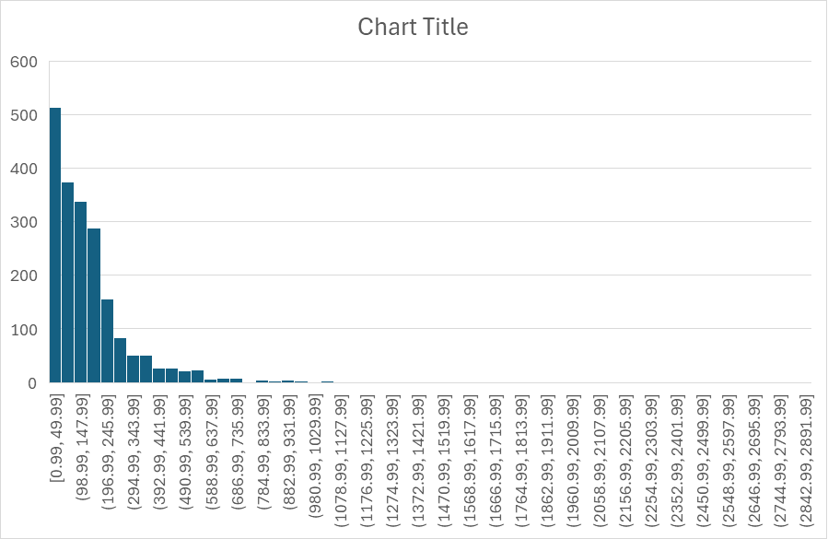
Exploratory Data Analysis (EDA) - Part 1
Distribution of Price:
Chart: Histogram of the price column.
Insight: The data is heavily right-skewed. Most items are priced under $500, with very few expensive outliers .
Distribution of Units Sold:
Chart: Histogram of the sold column.
Insight: Like price, this is very right-skewed. Most items have few sales, while a handful of items are "bestsellers" with 8,000-10,000+ sales .

Slide 71
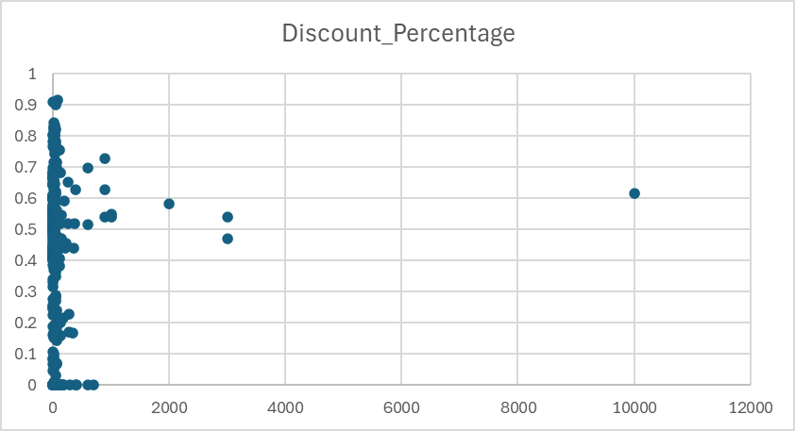
Exploratory Data Analysis (EDA) - Part 2
Price vs. Units Sold:
Chart: Scatter plot (price on X-axis, sold on Y-axis).
Insight: There's a negative relationship. High-volume sales (over 2,000 units) only occur on items priced under $500.

Slide 72
Feature Engineering
Goal: To create new, meaningful features from existing data to improve model accuracy.
Text Analysis (productTitle):
Since Excel can't use TfidfVectorizer, I used a manual approach.
Action: Used =IF(ISNUMBER(SEARCH("Keyword", [productTitle]))) to create new binary (1/0) columns for common keywords.
New Features: is_Dresser, is_Chair, is_Outdoor, is_Table, etc.

Slide 73
Business Recommendations
Pricing: To maximize sales volume, sellers should focus on competitive pricing, ideally under the [e.g., $100] mark where sales are most frequent.
Listings: Optimize product titles (productTitle) to include high-performing keywords identified in the analysis.
Shipping: "Free shipping" should be offered as a default to remain competitive.

Slide 74
Conclusions
Conclusion 1: Price is a significant driver of sales. The negative coefficient from our model confirms that as price increases, the number of units sold decreases.
Conclusion 2: Product category is crucial. Keywords like "Dresser" (or whichever were significant for you) showed a strong positive relationship with sales.
Conclusion 3: "Free shipping" is no longer a perk; it's a market standard. Its presence was a significant (though small) positive predictor in the model.

Slide 75
PROJECT 7

Slide 76
Colorado Motor Vehicle Sales: A Data-Driven Analysis & Forecast
Presented By : Mufaddal Jhalod

Slide 77
What We Aimed to Achieve
To clean and prepare raw sales data from 2008-2015 for analysis.
To analyze and visualize long-term sales trends.
To identify the top-performing counties and understand regional market share.
To uncover seasonal sales patterns.
To build an interactive dashboard in Excel for easy data exploration.

Slide 78
The Raw Material: Our Dataset
Source: colorado_motor_vehicle_sales.csv
Scope:
501 records of quarterly sales data from 2008 to 2015.
Key Data Points (Columns):
Year: The calendar year (2008-2015)
Quarter: The quarter of the year (1-4)
County: The county in Colorado
Sales: Total dollar sales for that period

Slide 79
Handling Data Inconsistencies
The Problem:
Early data (pre-2012) listed "Boulder/Broomfield" as a single entry.
Later data (post-2012) split them into "Boulder" and "Broomfield" separately.
The Solution:
Created a new standardized column: County (Std).
Used an Excel formula (=IF(C2="Boulder/Broomfield", "Boulder-Broomfield (Combined)", C2)) to merge them.

Slide 80
From Quarters to a Real Timeline
The Challenge: Year and Quarter are separate number columns, which Excel's time-series tools can't use effectively.
The Solution:
Created a new Date column.
Used the formula =DATE(A2, (B2*3)-2, 1) to convert the year and quarter into the first day of that quarter (e.g., 2008, Q1 -> 1/1/2008).

Slide 81
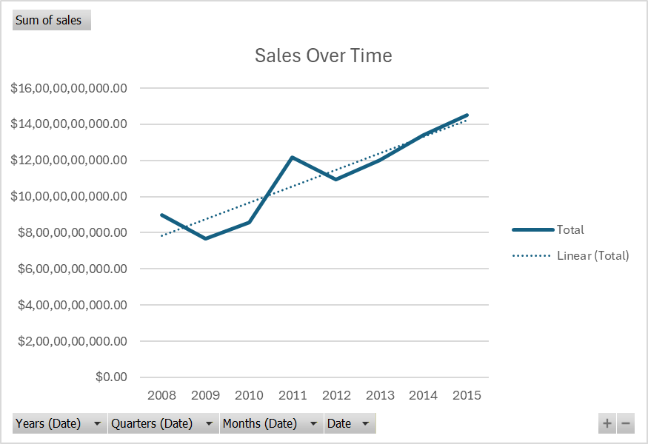
The Big Picture: Sales are Growing
Sales show a significant dip in 2009, likely corresponding to the financial crisis.
From 2010 onwards, there is a strong, consistent upward trend in vehicle sales.
The trendline indicates a healthy, growth trajectory for the market.

Slide 82
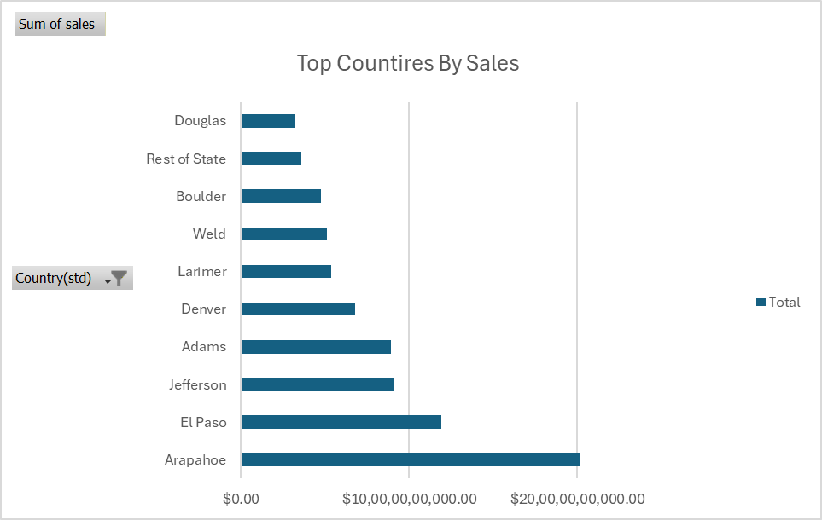
Where is the Market Concentrated?
The market is highly concentrated. The top 5 counties (Arapahoe, Denver, El Paso, Jefferson, Adams) account for most of all sales.
Arapahoe County is the clear market leader, with sales significantly higher than all other counties.
The combined "Boulder-Broomfield" entity is also a top-tier market.

Slide 83
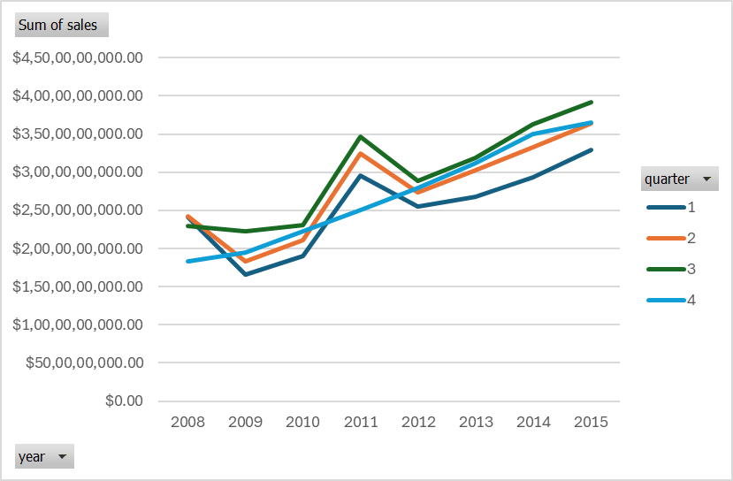
When Do People Buy Cars?
There is a very strong and consistent seasonal pattern.
Q2 (April-June) is consistently the highest sales quarter, year after year.
Q1 (Jan-March) is almost always the slowest sales quarter.
This suggests consumer behavior is tied to seasons (e.g., tax refunds, better weather).

Slide 84
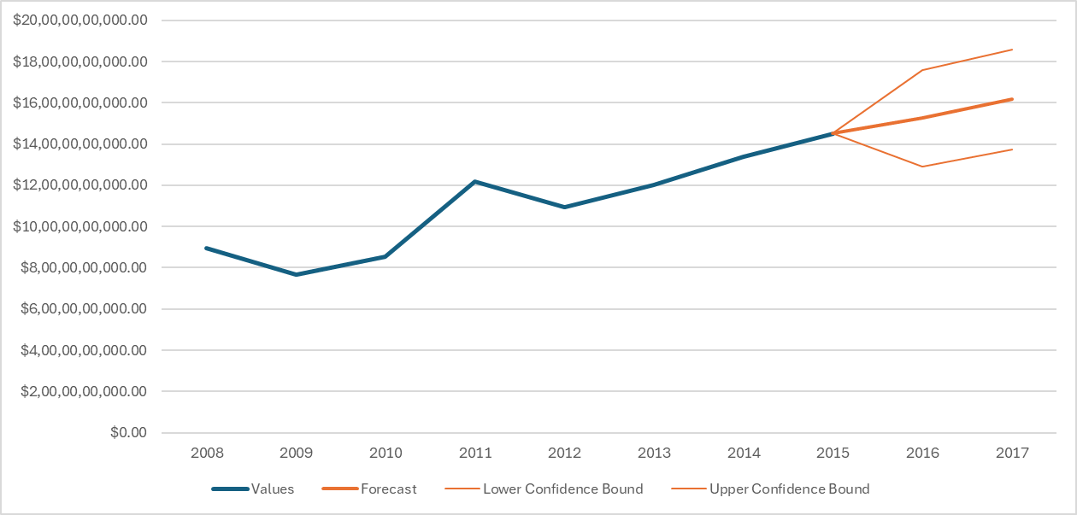
Sales Forecast
Methodology:
Used Excel's built-in Forecast Sheet tool.
The Forecast:
The model predicts continued sales growth.
It also predicts the seasonal peaks (in Q2) and troughs (in Q1) will continue.

Slide 85
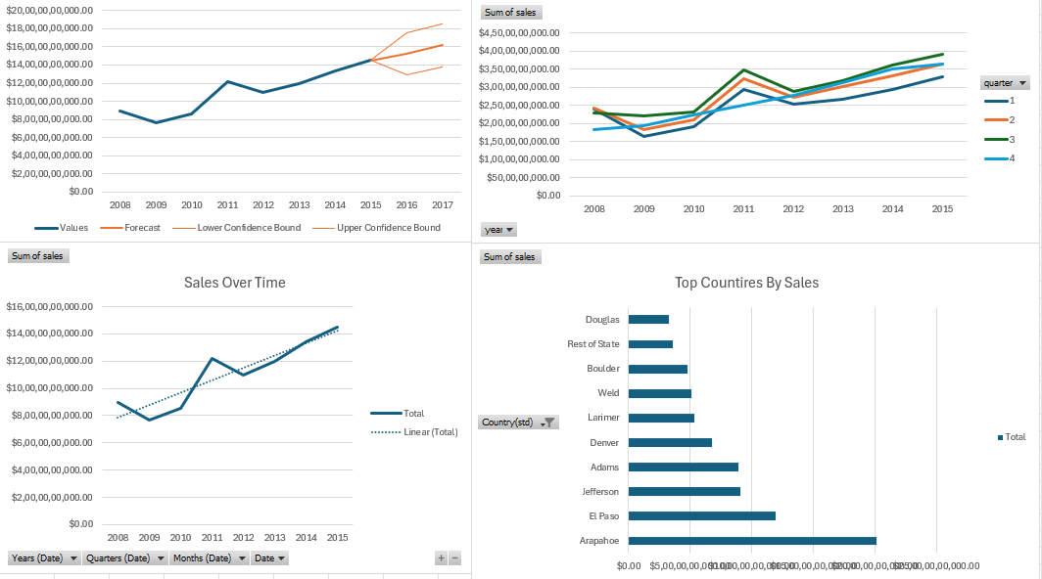
A Tool for Exploration
Features:
Combines all key charts (Trend, County, Seasonality) in one view.
Includes interactive Slicers for Year and County (Std).

Slide 86
What We Learned & What to Do
Insights:
The market is healthy and has recovered strongly since 2009.
Sales are driven by a few key metropolitan counties.
Sales are highly seasonal, with Q2 being the "car buying season.“
Recommendations:
Marketing: Focus marketing budgets and campaigns to align with the Q2 peak.
Inventory: Ensure inventory levels in top counties (Arapahoe, Denver) are highest leading into Q2.
Expansion: Use the "Rest of State" and other mid-tier counties as potential areas for market growth.

Slide 87
Conclusion
Summary:
We successfully cleaned, analyzed, and modeled the Colorado motor vehicle sales data.
We identified key trends, regional leaders, and seasonal patterns.
We delivered a forecast and a functional dashboard for ongoing analysis.

Slide 88
THANK YOU

